Slide 1


Time-lagged Impact of Spring Sensible Heat Source over the Tibetan Plateau on the Summer Rainfall Anomaly in East China
Wang Ziqian, Duan Anmin, and Wu Guoxiong
wzq@lasg.iap.ac.cn
State Key Laboratory of Numerical Modeling for Atmospheric Sciences and Geophysical Fluid Dynamics (LASG),
Institute of Atmospheric Physics (IAP), Chinese Academy of Sciences (CAS), Beijing 100029, China
Kathmandu, Nepal, 2013-08-27
The 2nd WCRP CORDEX and Training Workshop in South Asia
Wang Z. Q., Duan, A. M., and Wu G. X., 2013, Time-lagged impact of spring sensible heat over the Tibetan Plateau on the summer rainfall anomaly in East China: case studies using the WRF model. Clim. Dyn., Online published.

Slide 2
Introduction
Features of diabatic heating in different seasons over the Tibetan Plateau (TP):
Yin 1949, Yeh 1950, Flohn 1957, Yeh et al. 1957, Murakami 1958, Koteswaram 1958, and Staff Members of Academia Sinica 1958; Luo and Yanai 1983;1984; Yanai et al., 1992;1994; Zhao and Chen 2001; Duan et al., 2003, 2011; Zhu et al., 2012; ......
Role of the TP mechanical and thermal forcings in the formation of summer monsoon circulation and weather systems over East China:
Yeh et al. 1957; Flohn 1957, 1960; Hahn and Manabe 1975; Tao and Ding 1981; Broccoli and Manabe 1992; Li and Yanai 1996; Wu et al., 1997; Wu and Zhang 1998; Duan and Wu 2005; Wu et al., 2012; Liu et al., 2012; ......

Slide 3
Seasonal evolution of East Asian monsoon Index
Vertical shear of zonal wind (200hPa-850hPa)
Vertical shear of meridional wind (200hPa-850hPa)
Climatology:
Experiments
with AGCM:
Time
Strong (SH150) and weak (SH50) spring SH over the TP (c & d)
Early reversal of land-sea thermal contrast
Duan et al., 2013, J. Climate
Notes:
Trends in Summer Rainfall over China Associated with the TP SH Source during 1980-2008.
3

Slide 4
Impact of spring SH on 850 hPa circulation and moisture divergence
Spring
Summer
Climatology:
Difference between
SH150 and SH50:
Strong Spring SH
Excessive summer rainfall in North China
Duan et al., 2013, J. Climate
Notes:
4

Slide 5
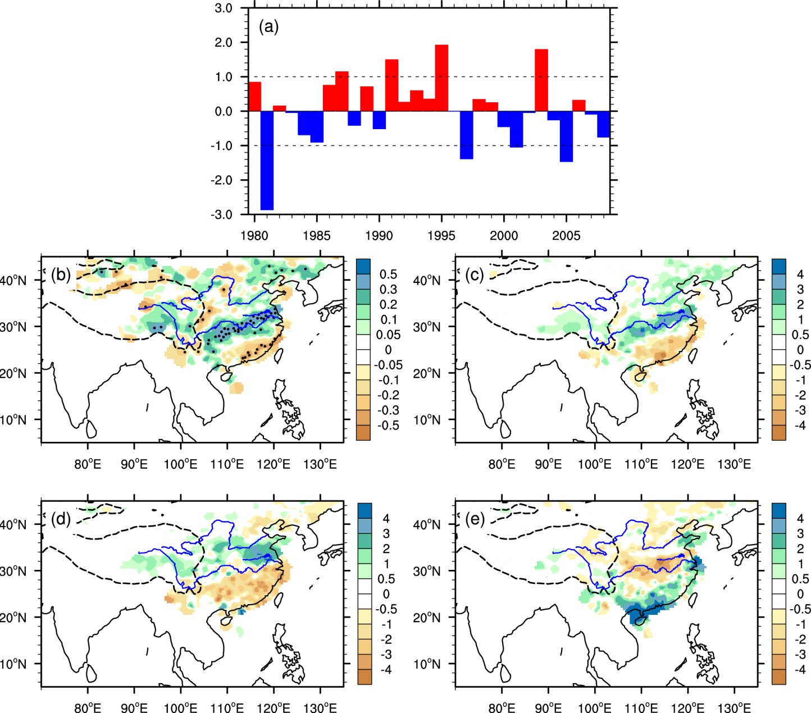
Statistical relationship between spring SH and summer rainfall over East China in interannual variation
(a) Spring SH index over the TP (Detrend)
(b) Cor. between the spring SH and summer rainfall
(c) Rainfall
difference between strongest and weakest years
(d) 2003 rainfall
anomaly
(e) 2001 rainfall
anomaly
No strong ENSO signal and low snow cover !
Notes:
The spring SH and precipitation are linearly detrended before the correlation is calculated.
Strongest years: 1987, 1991, 1995, 2003; Weakest years: 1981, 1997, 2001, 2005.

Slide 6
Motivation
How does the spring SH anomaly over the TP retain its influence until summer and affect the local atmospheric heat source?
Why does the strong spring SH source over the TP favor excessive precipitation in the Yangtze and Huaihe River basins?
Data
SH (73 stations, calculated by CMA observed data)
Precipitation (602 stations and TRMM 3B42)
NCEP-FNL
NOAA OISST
Notes:
SH was calculated by the bulk aerodynamic

Slide 7
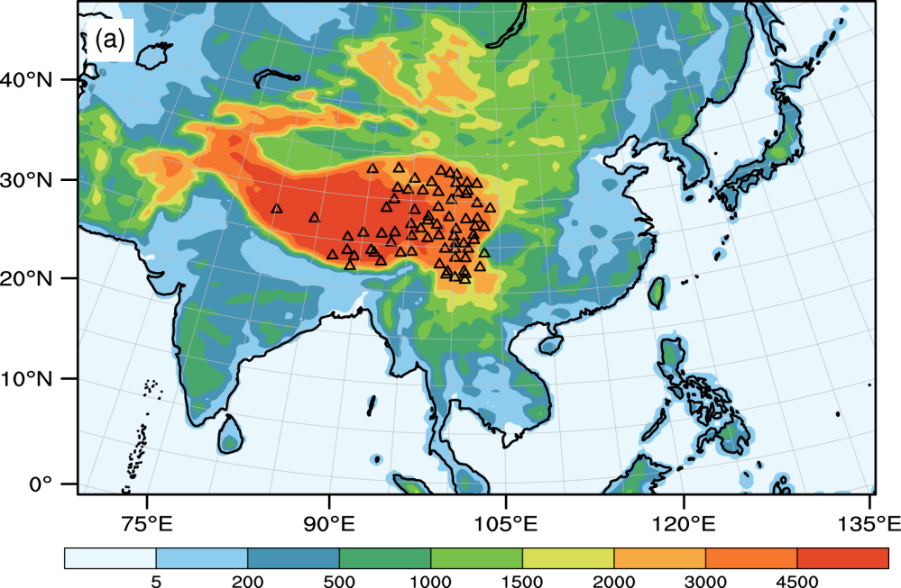
Domain and physical schemes in WRF
Model: WRF3.4
Integration time step: 240 s
Horizontal resolution: 45km (181×131)
Buffer zone: 10 gird points
Vertical levels: 35 (top: 50hPa)
Boundary condition: NCEP-FNL (6h)
SST condition: NOAA OISST (daily)
Simulation period: 28 Feb – 31 Aug
Physical schemes:
Cumulus convection: Grell-Devenyi
Cloud microphysics: Lin et al.
PBL: BouLac
Land surface: Noah
Shortwave radiation: Goddard
Longwave radiation: RRTM
Model domain:
Sensitivity experimental area :
(25-40N, 70-105E, >2km)
Notes:
The model domain covers the entire ASM region, and the SH is prescribed at grids higher than 2000 m above sea level with the area of 25N-40N, 70E-105E is prescribed in the sensitive runs
The simulation period for is from 28 Feb to 31 Aug. Note that the SH is prescribed only in March-May. After that, the results are generated by model itself.

Slide 8
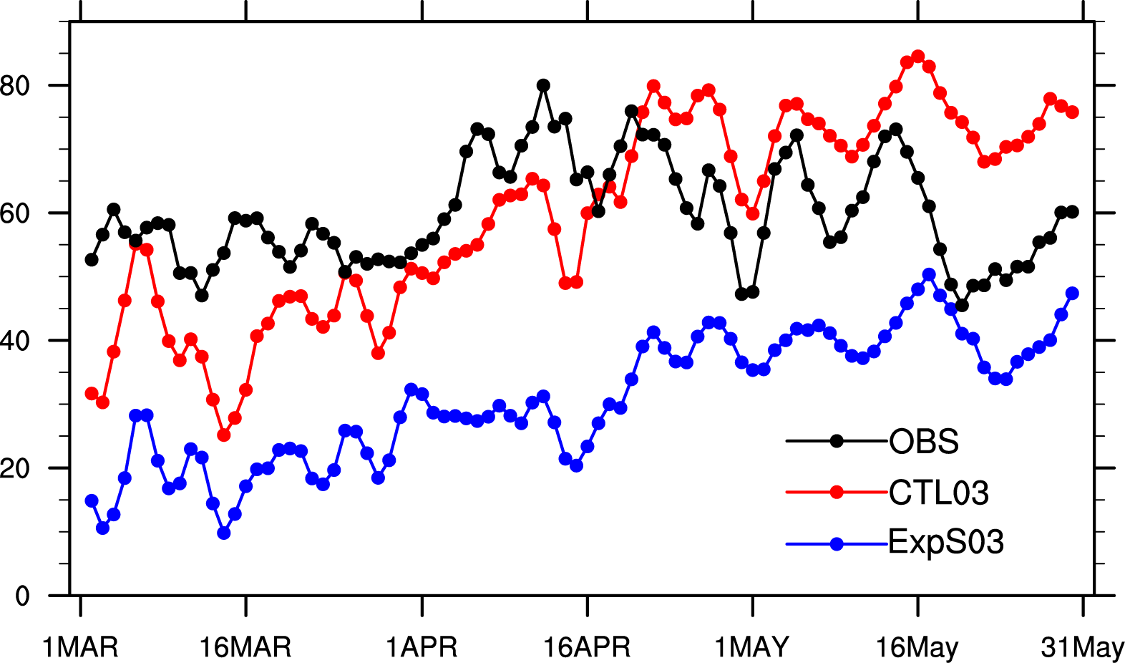
Numerical experiments
Experiments | Spring SH intensity over the TP | Goal
CTL03 | 100% | Examine the WRF performance of 2003 EASM
ExpS03 | 50% of the normal | Estimate effects of spring SH anomaly over the TP on 2003 EASM
CTL01 | 100% | Examine the WRF performance of 2001 EASM
ExpS01 | 150% of the normal | Estimate effects of spring SH anomaly over the TP on 2001 EASM
Temporal evolution of the observed
and simulated daily SH averaged at
73 stations over the TP in the spring of 2003. (W/m²)

Slide 9
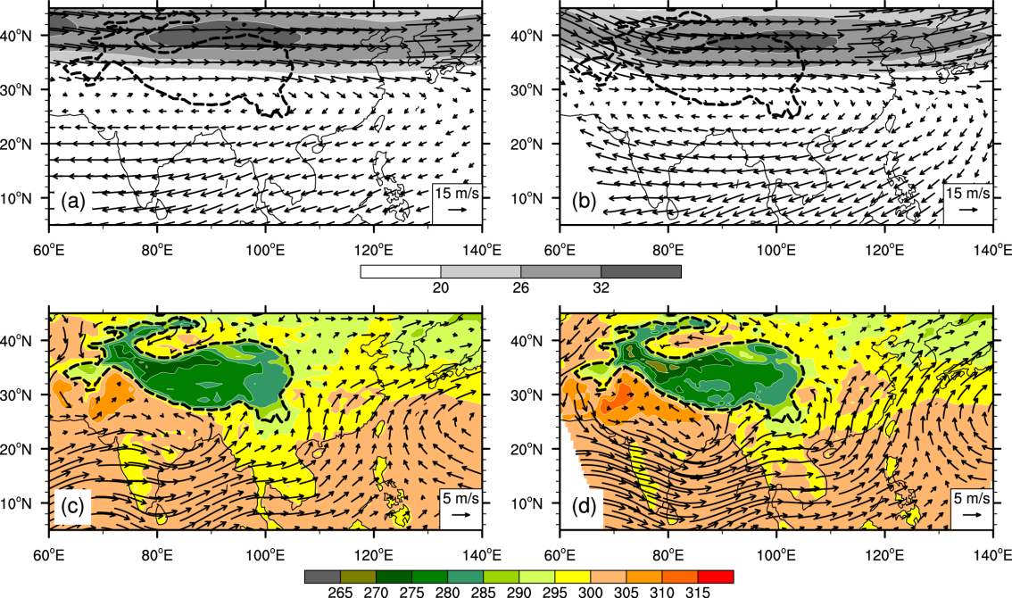
2003 JJA circulation in data and simulation
NCEP-FNL
WRF (CTL03)
200 hPa
A
A
850 hPa
(a)&(b) 200 hPa wind vectors (m s⁻¹) and the westerly jet stream(shading, m s⁻¹)
(c)&(d) 850 hPa wind vectors (m s⁻¹) and air temperature at 2m (shading, K)

Slide 10
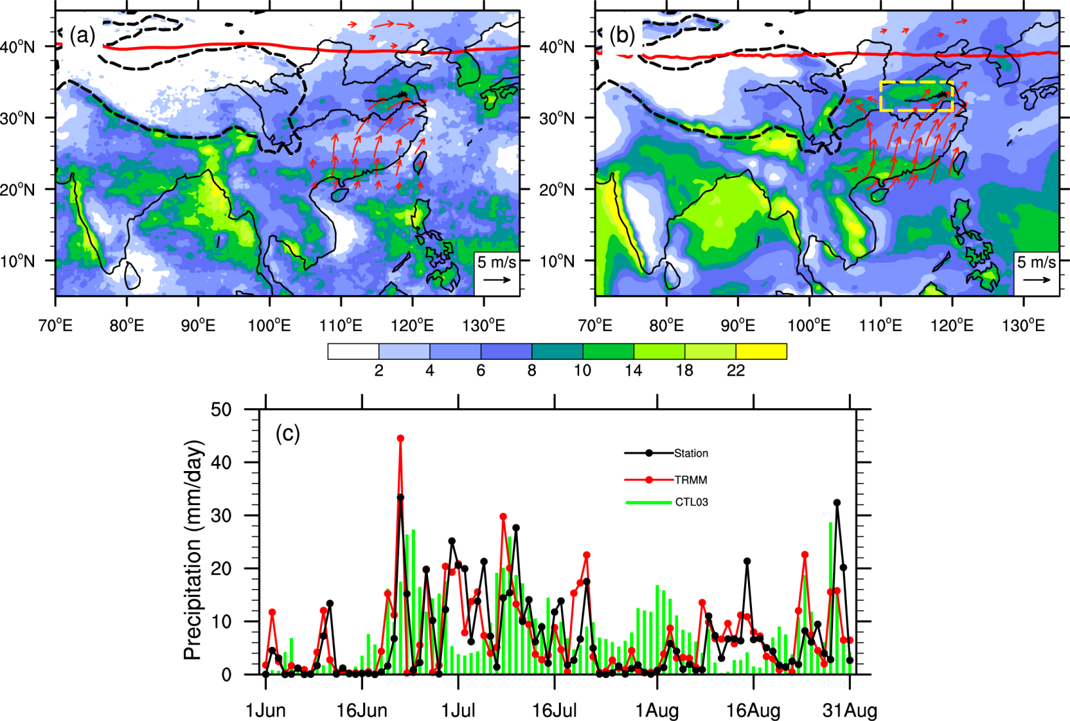
2003 JJA precipitation in data and simulation
OBS(TRMM)
WRF (CTL03)
Daily precipitation
(a)&(b) Summer precipitation field (shading, mm day⁻¹), 200 hPa wsterly jet axis (red solid curve), 850 hPa southwesterly jet (> 2 m s⁻¹, red vectors) over East China. (c) Time series of the area-averaged daily precipitation over the Huaihe River basin (31-35N, 110-120E)

Slide 11
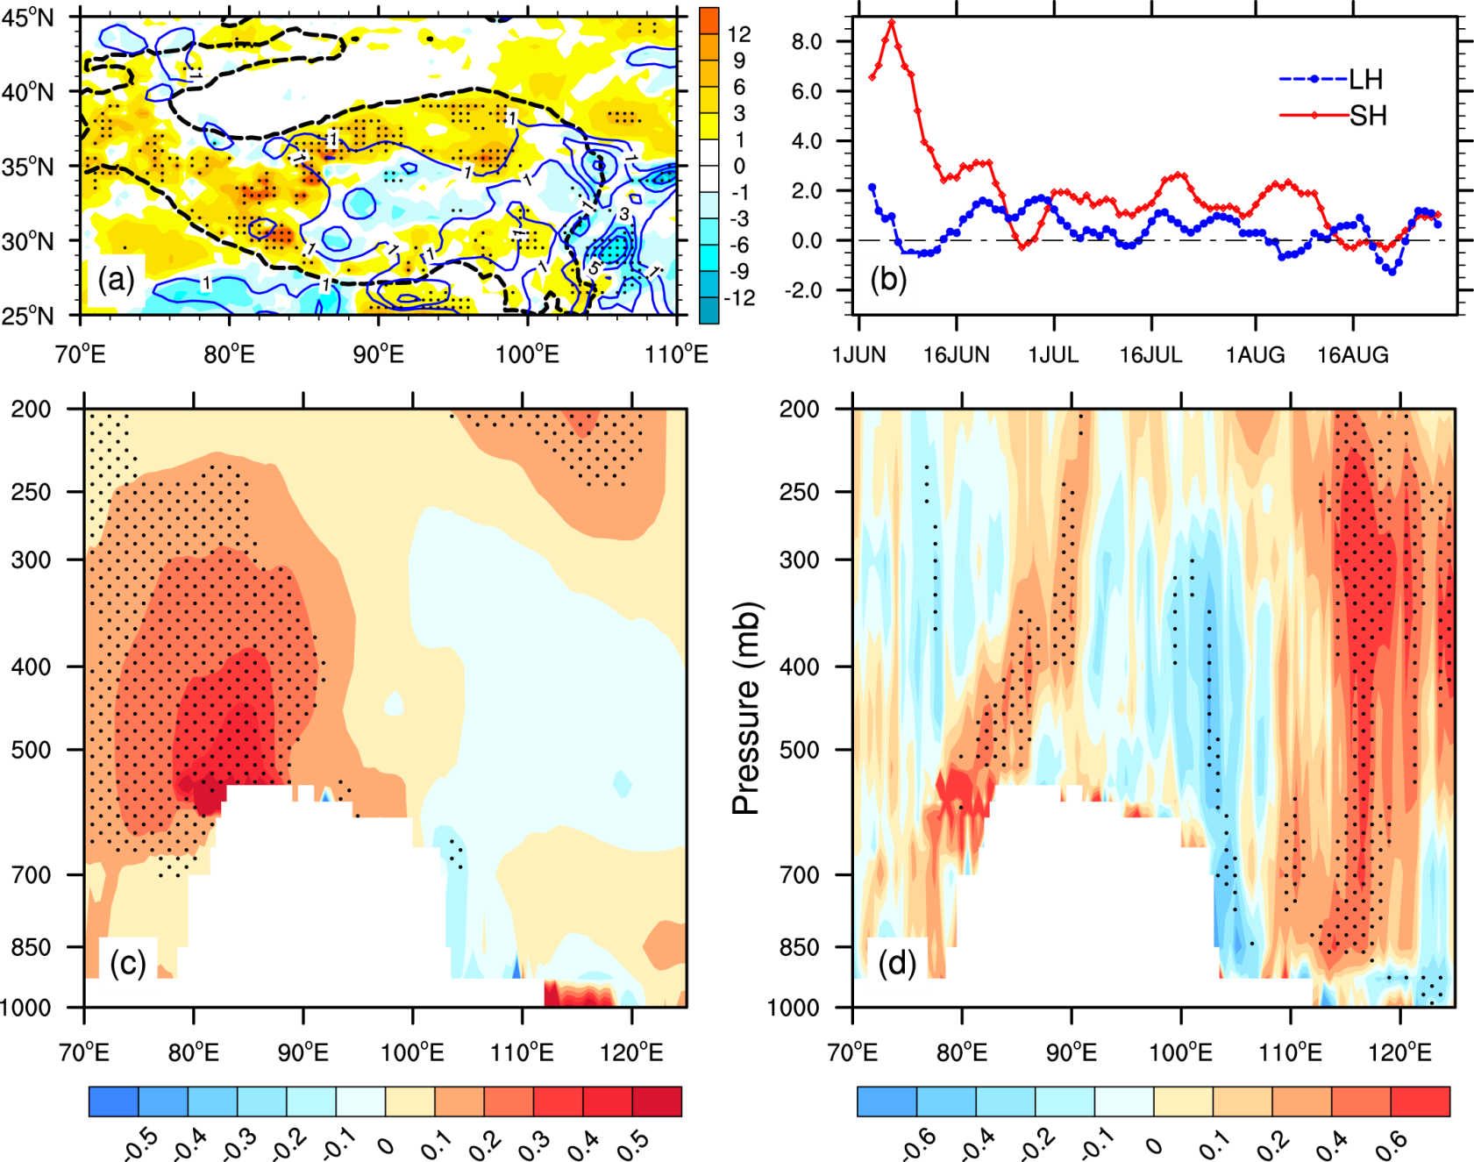
Simulated diabatic heating over the TP in 2003 summer (CTL03-ExpS03)
(a) SH (shading)
Positive LH (contour)
(b) TP domain-averaged SH (red) and LH (blue)
(c) Air temperature (30-36N)
(d) Diabatic heating (30-36N)
Notes:
TP domain: (25-40N, 70-105E, >=2km)
Can the spring SH anomaly over the TP persist until summer? To clarify this point, we show the difference field of summer SH between CTL03 and ExpS03 in Fig. 5a. An obvious positive SH anomaly with a magnitude above 3 Wm^{–2} remains over the northwestern TP after spring. In the climate mean, the dominant surface heat flux over the northwestern TP in summer is SH, while latent heat dominates the atmospheric diabatic heating in the southeastern TP due to monsoon precipitation. The time series of the TP domain-averaged differences of daily SH and latent heat between the CTL03 and ExpS03 runs are shown in Fig. 5b. Note that the positive SH signal persists until the end of July over the TP. The domain-averaged latent heat that is also presented, tends to be amplified. More details of the thermal forcing over the TP in summer 2003 can be obtained by examining the vertical structure of the air temperature and diabatic heating differences between CTL03 and ExpS03. The difference in temperature over the TP region (30–36°N) shows that the persistent summer SH in the western TP increases the air temperature efficiently above it, with the maximum temperature difference of ~0.4 K near the surface (Fig.5c). The pressure–longitude cross-section of difference in atmospheric diabatic heating shown in Fig. 5d displays an eastward tilting in the vertical of the positive heating over the western and mid TP, with the center appearing at about 500–350 hPa. Both the SH over the western TP and the latent heating to the east are intensified in summer due to the strong air-pumping effect of the spring SH.
When a positive SH anomaly appears over the TP in spring, pumping and draining processes promote upward motion on its east side and downward motion on its west side. With the season evolution, the near-surface cyclonic anomaly and the anticyclonic anomaly driven by the strong spring SH coincide with the climate mean surface heat low and the gigantic SAH above it, further reinforcing both of them. Consequently, dry and cold northerlies favor enhanced SH over the western TP in summer, while wet and warm southerlies favor enhanced latent heating over the eastern TP. This assumption can be verified using the differences in summer circulation between CTL03 and ExpS03 (Fig. 6a–c). As a response to the positive diabatic heating over the western TP, an anomalous anticyclone is formed at 200 hPa, denoting the intensified SAH, while an anomalous cyclone around 85°E at 500 hPa enhances the surface heat low. Therefore, a positive feedback between diabatic heating and local circulation may contribute to the overall stronger summer atmospheric heat source over the TP.

Slide 12

Step 1: Positive feedback between local diabatic heating and circulation maintains the strong heating until summer over the TP
High
Heating
Low
TP
Thermal adaptation theory (Hoskins, 1991; Wu and Liu, 2000)
Notes:
This persistence of the spring SH over the TP can be explained by a positive feedback between local diabatic heating and circulation. With the seasonal evolution, air column over the TP becomes an atmospheric heat source, which induces the surface heat low and the Tibetan High in upper layers. When positive anomalous SH appears in spring, it will enhances this circulation regime. Subsequently, the cold and dry air from high latitudes, together with the accelerated surface flow will intensify the SH over the western TP. In contrast, warm and wet flow from tropics and upward motion will induces more precipitation and LH over the eastern TP.
12

Slide 13
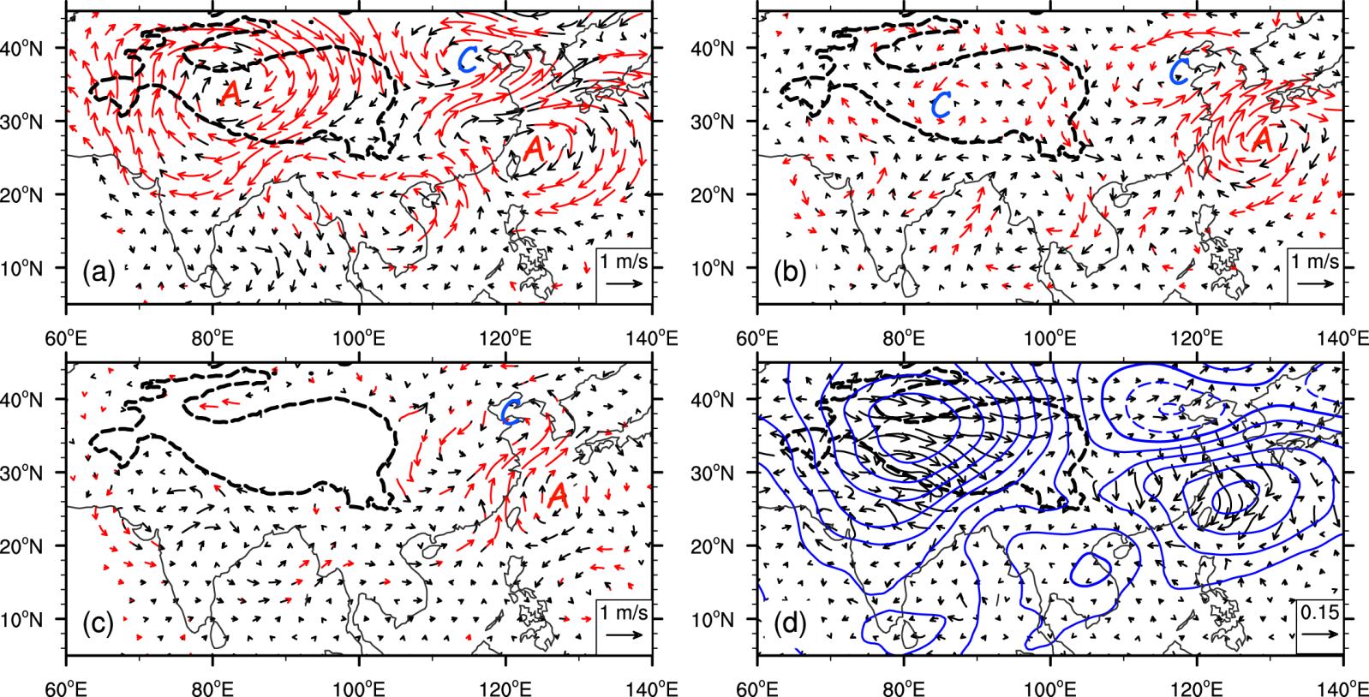
Responses of circulationto the TP thermal forcing in summer
(CTL03-ExpS03)
200 hPa
500 hPa
850 hPa
Wave-activity flux (vectors) and stream function (contours ) at 200 hPa (Takaya and Nakamura, 2001)
The red vectors exceed 0.1 significant level.
Notes:
Red vectors are significant at the 90% confidence level.

Slide 14
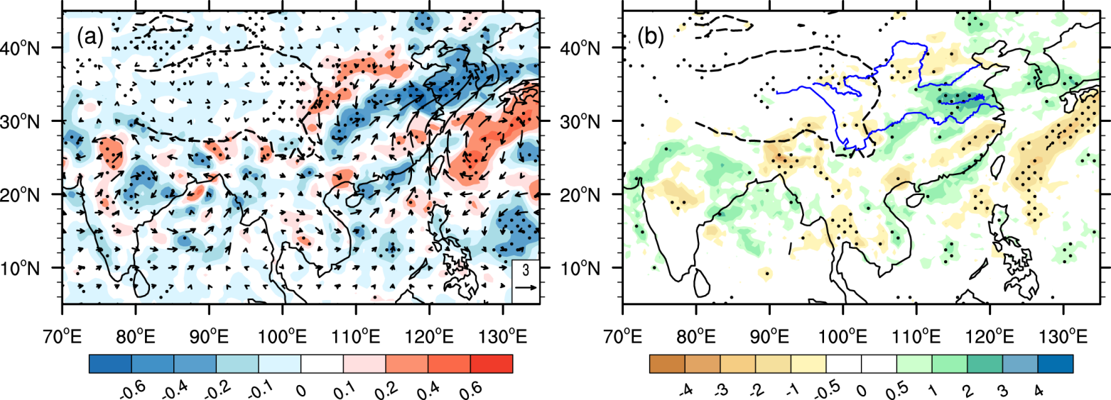
Responses of moisture transportation and rainfall to the TP thermal forcing in summer 2003 (CTL03-ExpS03)
Moisture transport (vector) and its divergence (shading)
Precipitation

Slide 15
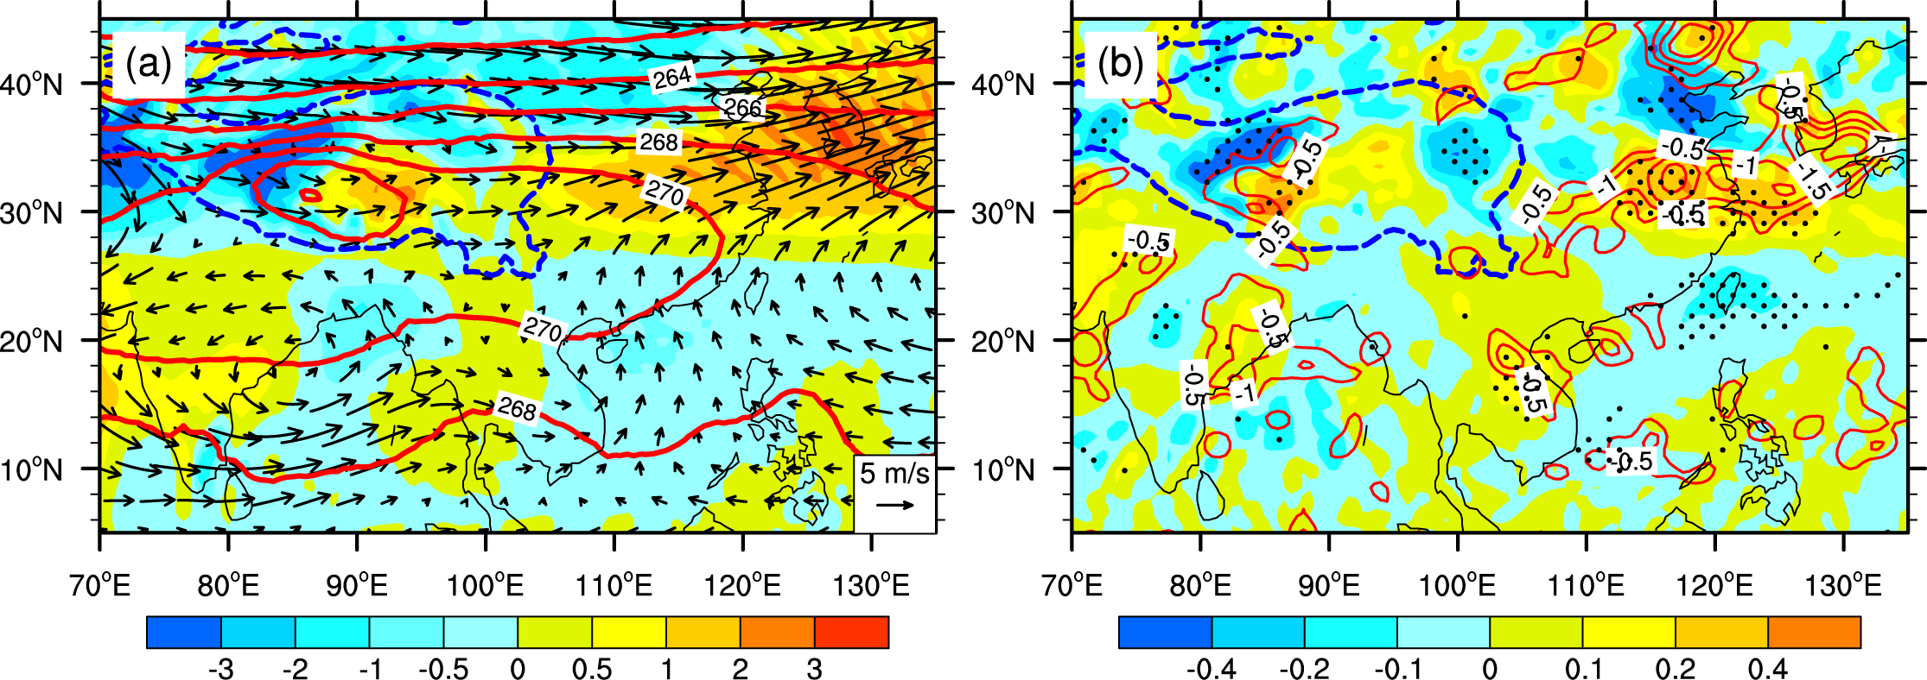
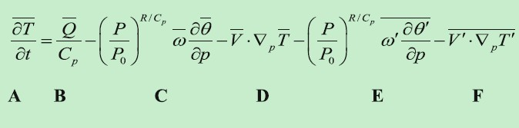
The warm temperature advection anomaly resulted from TP thermal forcing in the summer of 2003
Summer averaged air T (contours), T advection (shading), and wind vectors at 500 hPa for the CTL03
Difference (CTL03-ExpS03) fields of 500 hPa T advection (shading) and negative omega (upward motion, red contours)
Notes:
According to the thermodynamic equation, warm advection will intensify the upward motion and induce more convection activities over the Huaihe River basin.

Slide 16
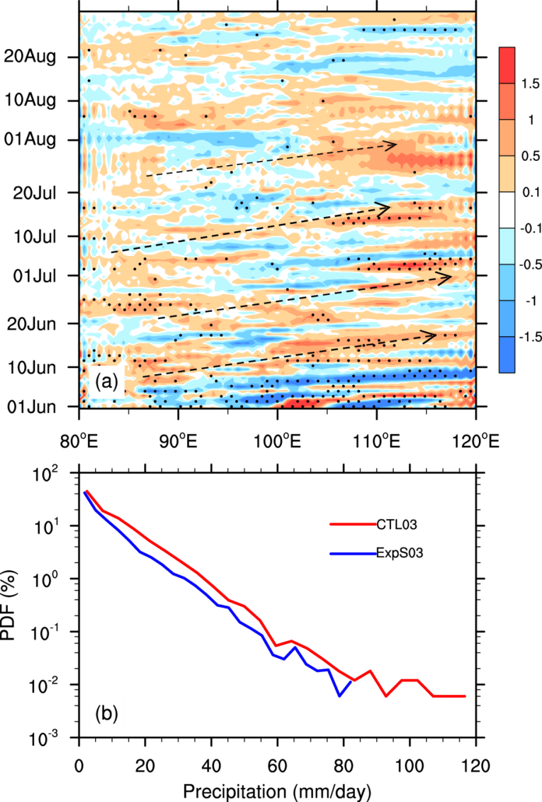
The eastward synoptic disturbances anomaly contributed from TP thermal forcing in the summer of 2003
Temporal-zonal cross-section of 500 hPa vorticity difference (CTL03-ExpS03) averaged from 30N to 36N
(b) Probability density function (PDF) of daily precipitation Over the Huaihe River basin

Slide 17
Step 2: Impact on summer rainfall anomaly in East China
Large scale circulation response :Steady wave
Excessive precipitation over the Yangtze and Huaihe River basins
Strong atmospheric heat source over the TP
Warm advection intensifies upward motion
Possible trigger: synoptic disturbance from the TP
Notes:
Strong atmospheric heat source over the TP induces the excessive precipitation over the east China by generating steady wave train, induces upward motion by warm advection, and providing synoptic triggers for torrential rainfall events.

Slide 18
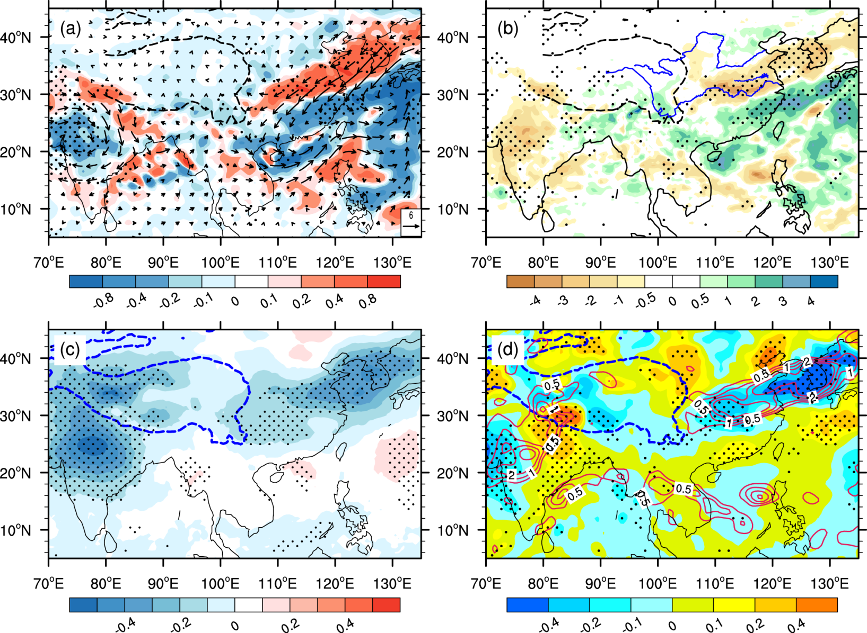
The simulation results for 2001 summer (CTL01-ExpS01)
Moisture transport (vector) and its divergence (shading)
Precipitation
Air T at 500 hPa
500 hPa T advection (shading) and positive
omega (downward motion, red contours)

Slide 19

Thanks for your attention !

Slide 20
When we consider the seasonal time scale, the temperature tendency term (A) is negligible, and the transient terms (E and F) are small in summer. The thermodynamic balance is attained mainly by the diabatic forcing term (B), the vertical temperature advection term (C), and the horizontal advection term (D).
The differences in diabatic heating between CTL03 and ExpS03 are positive over the Huaihe River basin, and differences in horizontal temperature advection are also positive . Therefore, the changes in the B and D terms in the above equation have the
same sign and must be balanced by a change in the vertical advection term (C). As a result, there will be stronger upward air motion (w<0) in the Huaihe River valley (dθ/dp<0). However, the diabatic heating strongly interacts with upward motion, and it is difficult to identify causality between them. Conversely, the horizontal temperature advection is independent of the local diabatic heating, as shown by Sampe and Xie (2010) with a linear baroclinic model, and it is produced by advecting warm air from the TP through the westerly jet stream. Therefore, the warm advection anomaly originating over the TP intensifies the upward motion substantially over the Huaihe River basin.

Slide 21
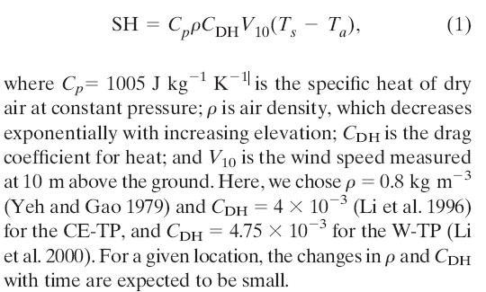
SH was calculated by the bulk aerodynamic method

Slide 22
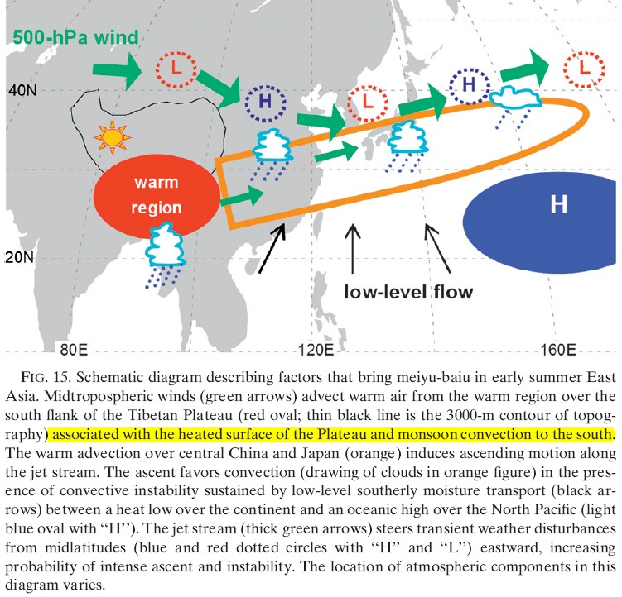
Sampe and Xie, 2010, J. Climate

Slide 23
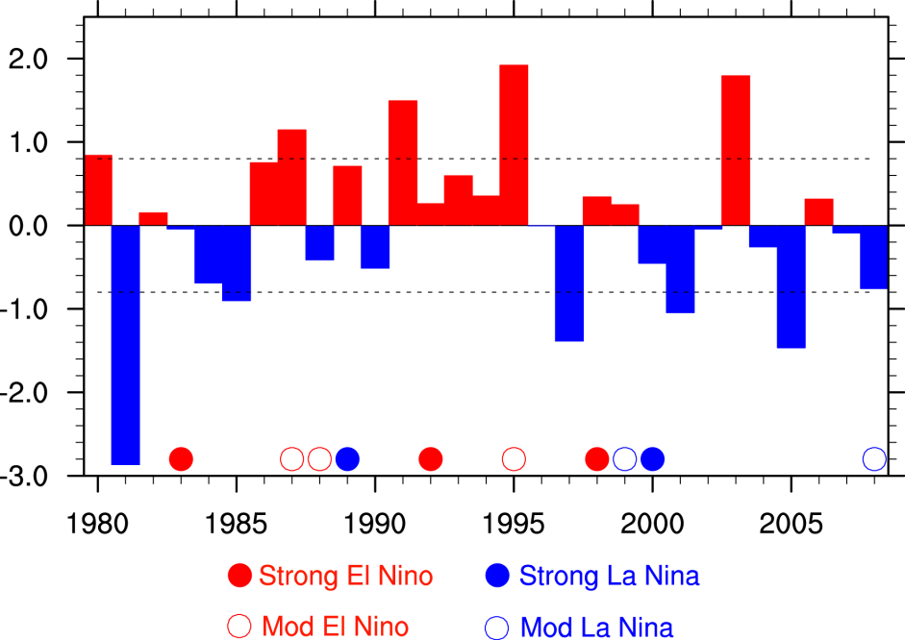
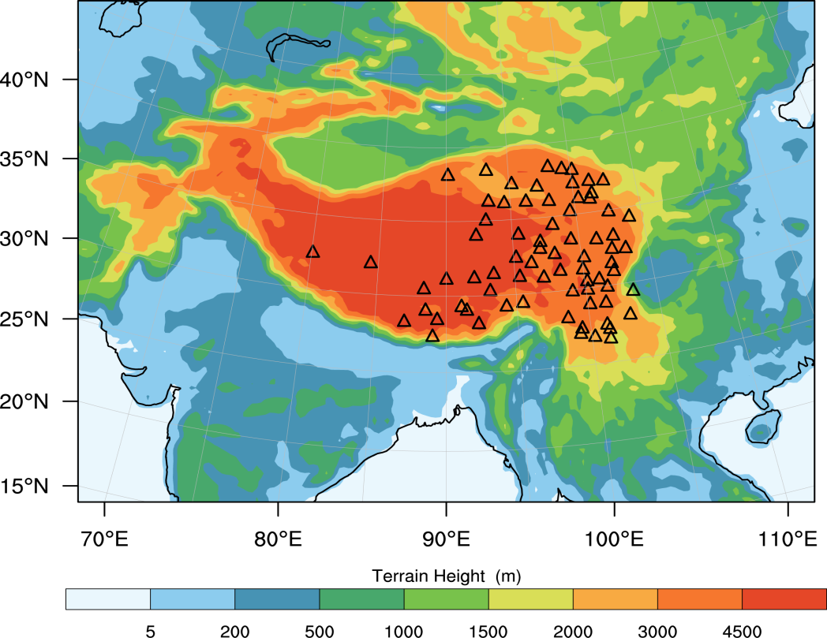
Spring SH over the TP (73-station):
Strong cases (S): 1980, 1987, 1991, 1995, 2003
Weak cases (W): 1981, 1985, 1997, 2001, 2005
Simulation period: 29 years:1980-2008 (02-20-00 ~ 08-31-18 very year)
Horizontal resolution: 30km
Physical schemes: Sameas the former, except the cumulus convection (KF here)
Forcing data: ERA-Interim (0.75*0.75)
Notes:
In addition to 2003 and 2001, we conducted 29 years run from 1980-2008, and choose 5 most significant strong (weak) spring SH over the TP for a composite analysis,

Slide 24
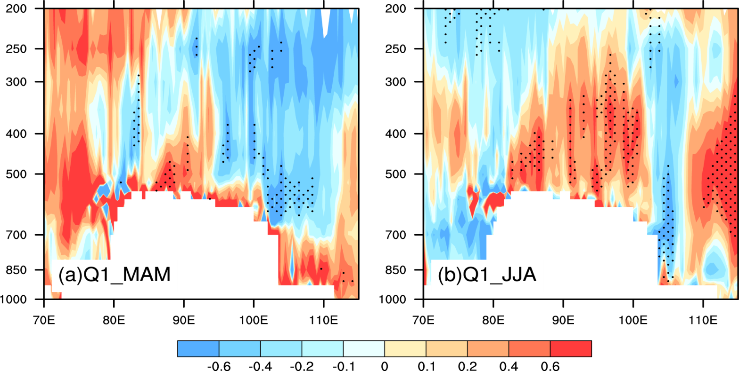
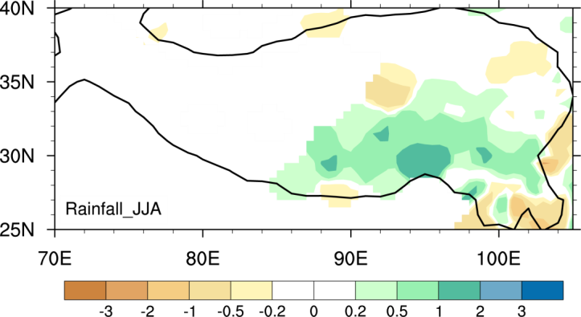
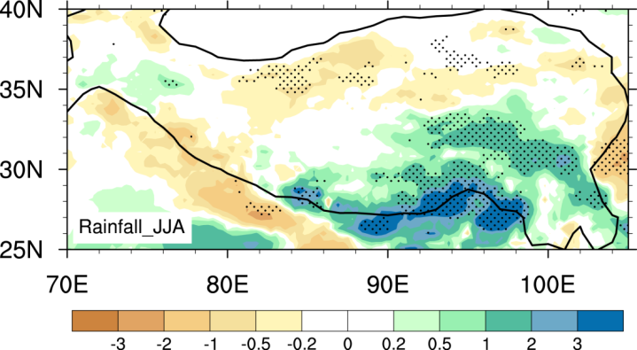
Discussion: other factors contributing to the interannual variability of EASM should be taken into account in future !
Spring
Summer
Diabatic heating Q1 (S-W)
(30-36N)
Summer precipitation (S-W)
OBS
WRF
Notes:
The persistence of the spring over the TP through the local positive feedback between diabatic heating and circulation has been further confirmed.

Slide 25
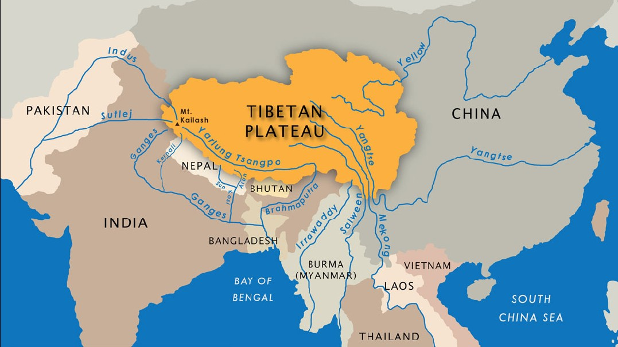
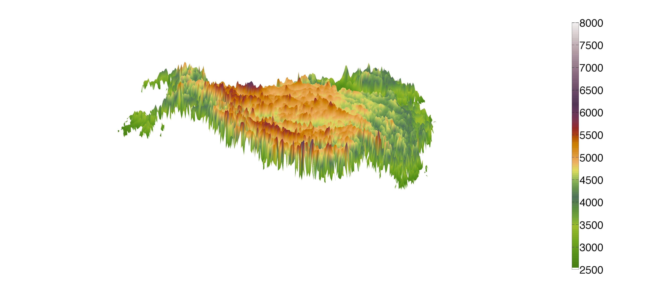
The schematic diagram of the TP forcing
200hPa
A
500hPa
C
V
V
V
Notes:
It is well documented that the TP exerts significant impacts on general circulation by its mechanical and thermal forcings. It winter, the topography splits the westerly jet into two braches and force part of the flow climb up the mountains. In summer, the TP serves as a huge elevated heat source, which generates a surface heat low and the Tibetan High in upper troposphere. The circulations driven by the TP thermal forcing and the continental heating are phase in East Asia, resulting in the strongest subtropical summer monsoon in the world. In addition, frequent synoptic vortex originated from the TP usually produces intense rainfall in the downstream.

